Slide 1
PUSL 2026 - Computer Networks
Lecture 3 – Network Devices and Equipment
Chamara Disanayake
Senior Lecturer
Department of Network and Security

Slide 2
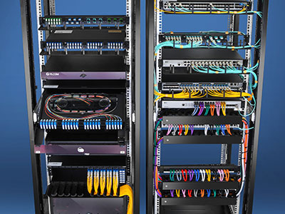
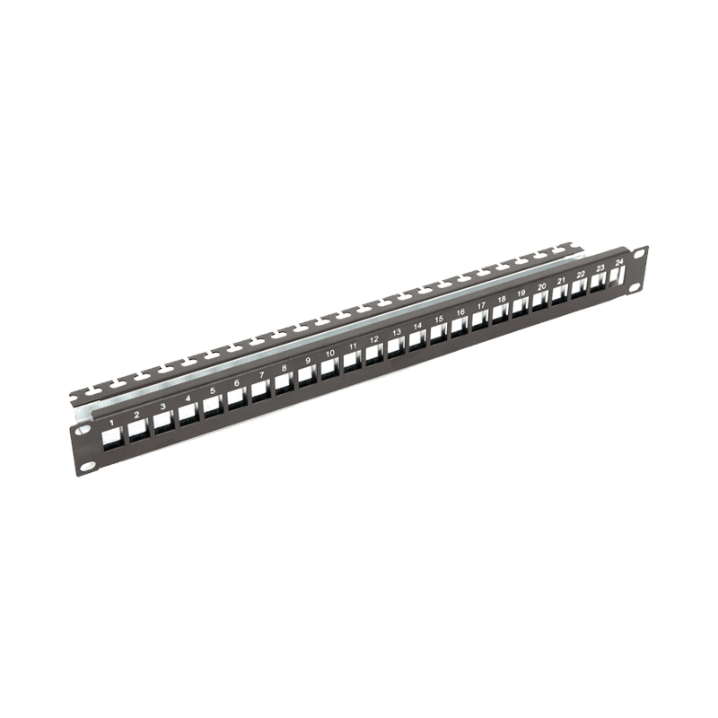
Network Hardware - Intermediate Devices
Active and Passive Devices
Passive Networking Hardware are those parts of computer network that are involved in data transmission in the network, but they don’t change or affect the data.
Cables (fiber optic cable, coaxial cables)
Connectors
Switchboards
Patch panels
Patch codes
Plugs

Slide 3
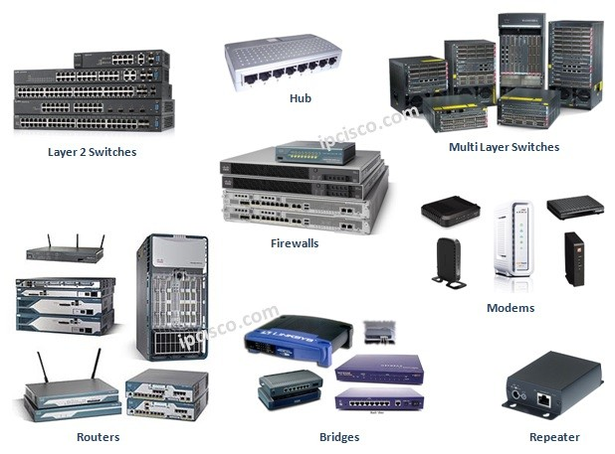
Active Devices
An active network device requires its own power and will amplify and clean network signals before repeating them to all ports on the hub, whereas a passive device is usually unpowered and only creates a physical connection to allow communication between network hosts.
Repeaters
Hubs
Switches
Bridges
Routers
Gateways
Access point (AP)

Slide 4

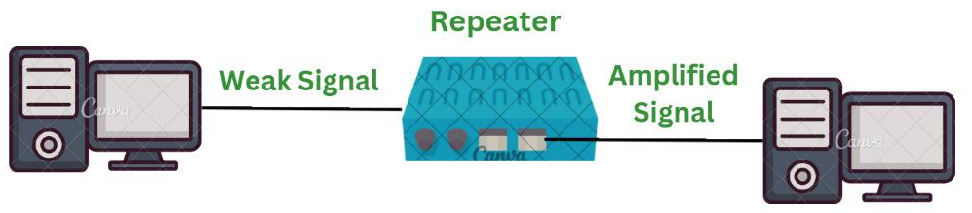
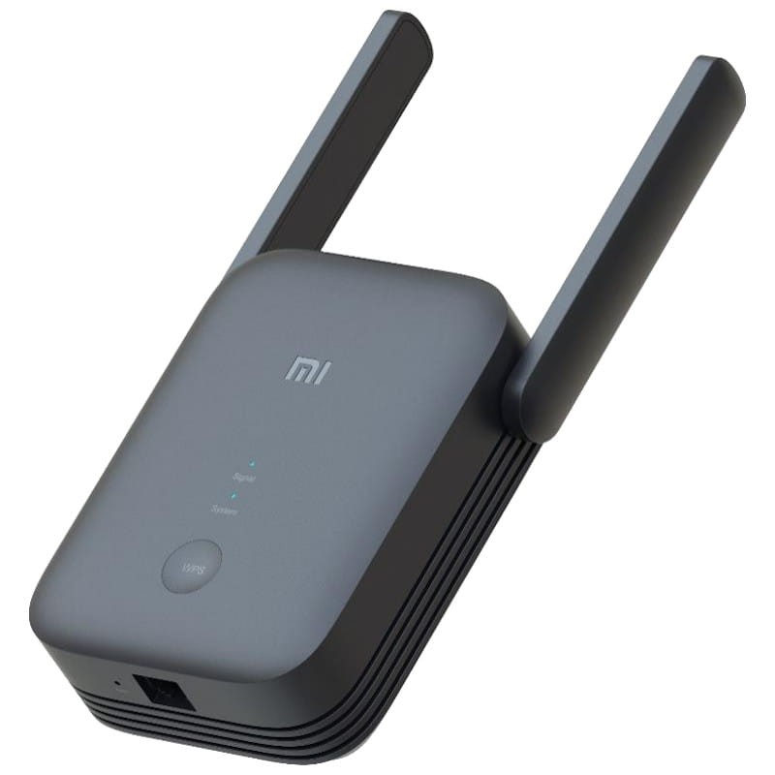
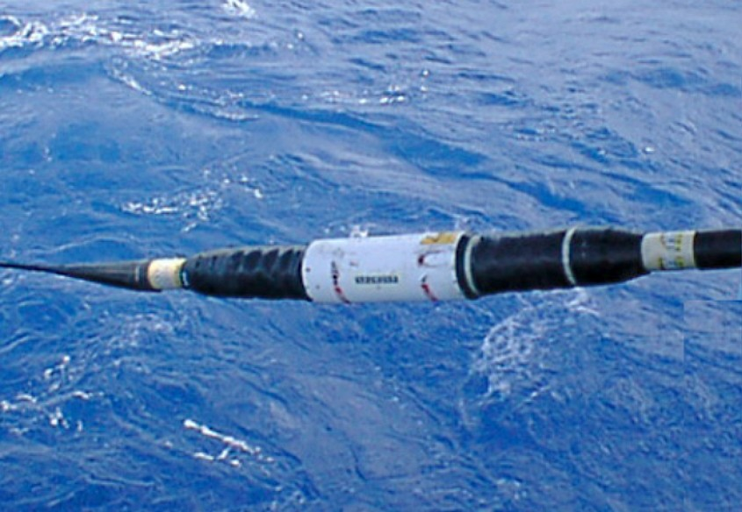
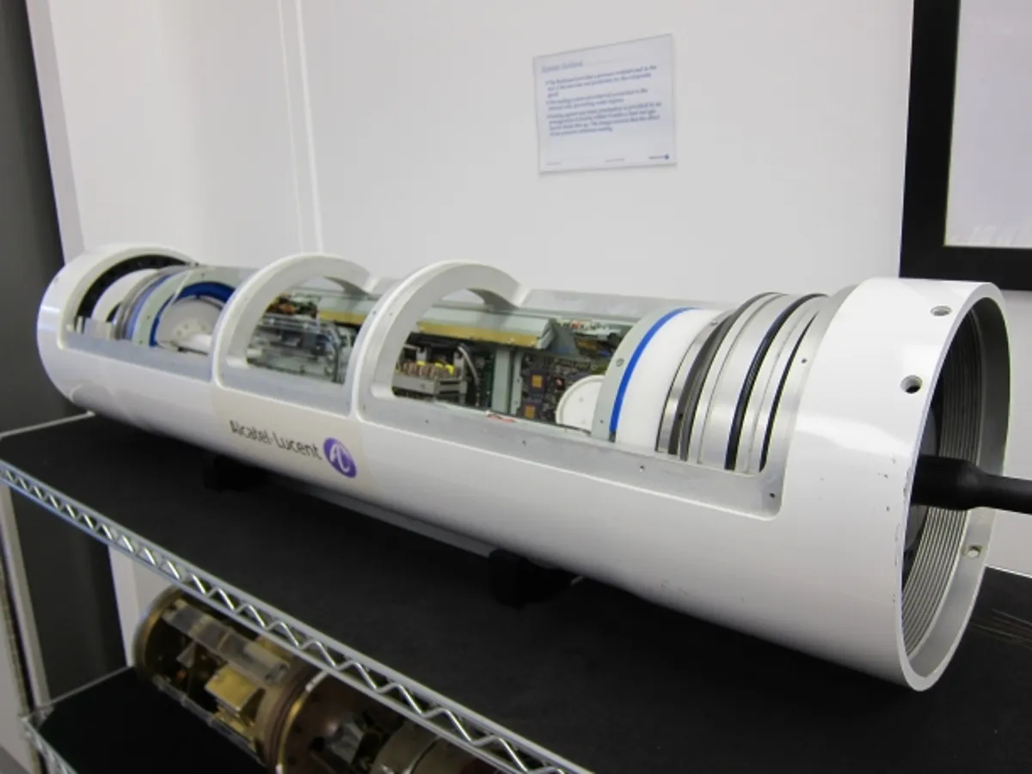
Repeaters
Used to amplify and generate the incoming signal.
Works in the physical layer of OSI model and need power.
Different types of repeaters used in different locations and technologies
This is one of Alcatel-Lucent's repeaters, which are used to amplify the signal at various points along the cable. This repeater, a model from two years ago, has a throughput of around 1.5 terabits per second.
Wi-Fi extenders

Slide 5
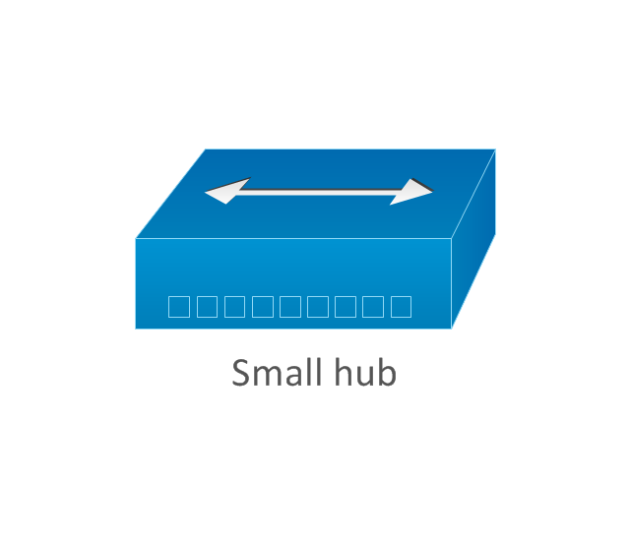
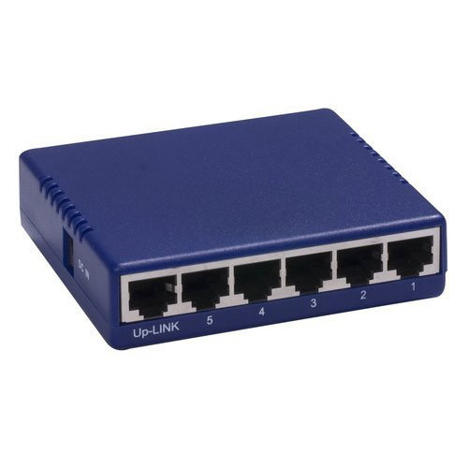
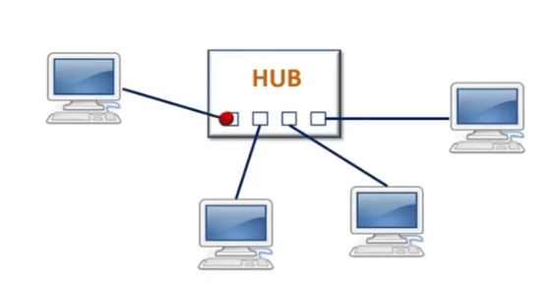
Hubs
A Hub is the place where data converges from one or more directions and is forwarded out in one or more directions.
Seen in local area networks ( not used much)
Hubs are unable to support networks that are as large as switches because hubs send all traffic to all devices on the network. The more devices you add, the slower the network gets, eventually becoming unusable.
Also, Hubs are broadcasting the traffic to all the ports
https://www.youtube.com/watch?v=hGVysWRvlJg

Slide 6
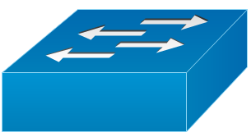
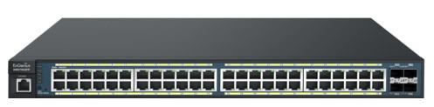
Switches
Allow different nodes of a network to communicate directly with each other.
Allow several users to send information over a network at the same time without slowing each other down.

Slide 7
Hub vs Switch
Please refer the video at https://www.youtube.com/watch?v=mPian6YtI1E

Slide 8
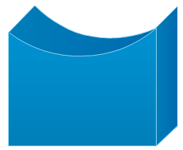
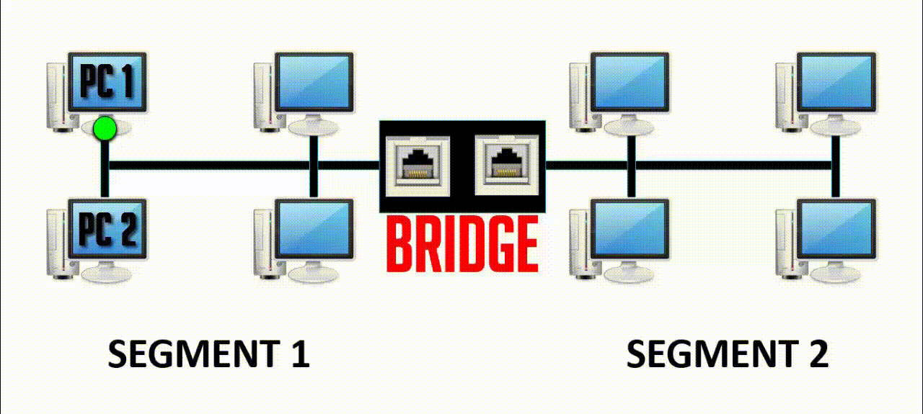
Bridge
A bridge is a product that connects a local area network (LAN) to another local area network that uses the same protocol (for example, Ethernet or token ring).
A bridge is a device that verifies every communication on a local area network (LAN), forwarding messages on other connected LANs and passing messages inside the same LAN.
Notes:
bridge
In telecommunication networks, a bridge is a product that connects a local area network (LAN) to another local area network that uses the same protocol (for example, Ethernet or token ring). You can envision a bridge as being a device that decides whether a message from you to someone else is going to the local area network in your building or to someone on the local area network in the building across the street. A bridge examines each message on a LAN, "passing" those known to be within the same LAN, and forwarding those known to be on the other interconnected LAN (or LANs).
In bridging networks, computer or node addresses have no specific relationship to location. For this reason, messages are sent out to every address on the network and accepted only by the intended destination node. Bridges learn which addresses are on which network and develop a learning table so that subsequent messages can be forwarded to the right network.
Bridging networks are generally always interconnected local area networks since broadcasting every message to all possible destinations would flood a larger network with unnecessary traffic. For this reason, router networks such as the Internet use a scheme that assigns addresses to nodes so that a message or packet can be forwarded only in one general direction rather than forwarded in all directions.
A bridge works at the data-link (physical network) level of a network, copying a data frame from one network to the next network along the communications path.
A bridge is sometimes combined with a router in a product called a brouter.

Slide 9
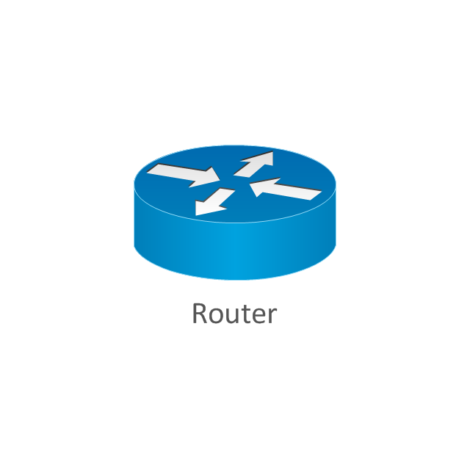
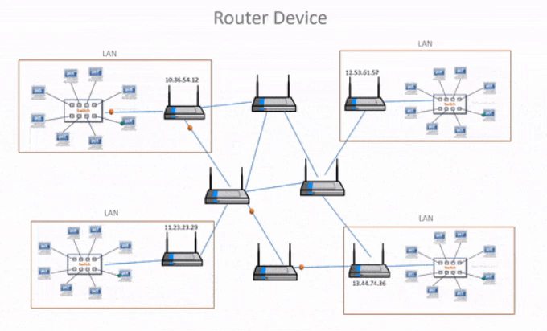
Routers
A router is a device or a software in a computer that determines the next network point to which a packet should be forwarded toward its destination.
Allow different networks to communicate with each other
A router creates and maintain a table of the available routes and their conditions and uses this information along with distance and cost algorithms to determine the best route for a given packet.
A packet will travel through a number of network points with routers before arriving at its destination.
https://www.thestudygenius.com/how-router-works/

Slide 10

Gateways
A gateway is a network point that acts as an entrance to another network. On the internet, in terms of routing, the network consists of gateway nodes and host nodes.
Host nodes are computer of network users and the computers that serve contents (such as Web pages).
Gateway nodes are computers that control traffic within your company’s network or at your local internet service provider (ISP)

Slide 11
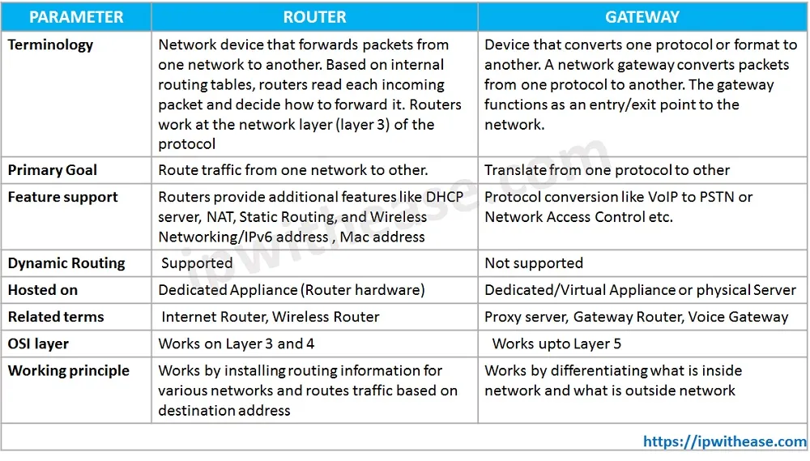
Router vs Gateway

Slide 12
What is the difference between?
Bridge: device to interconnect two LANs that use the SAME logical link control protocol but may use different medium access control protocols.
Router: device to interconnect SIMILAR networks, e.g. similar protocols and workstations and servers
Gateway: device to interconnect two different networks with same protocols and equipment

Slide 13
Network Types

Slide 14
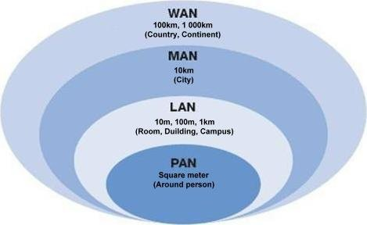
Network Categorization on Covering Area/Purpose
Computer networks are commonly classified based on both their purpose and size.
Personal area network, or PAN
Local area network, or LAN
Metropolitan area network, or MAN
Wide area network, or WAN
Some of the different networks based on their main purpose are
Storage area network, or SAN
Enterprise private network, or EPN
Virtual private network, or VPN

Slide 15
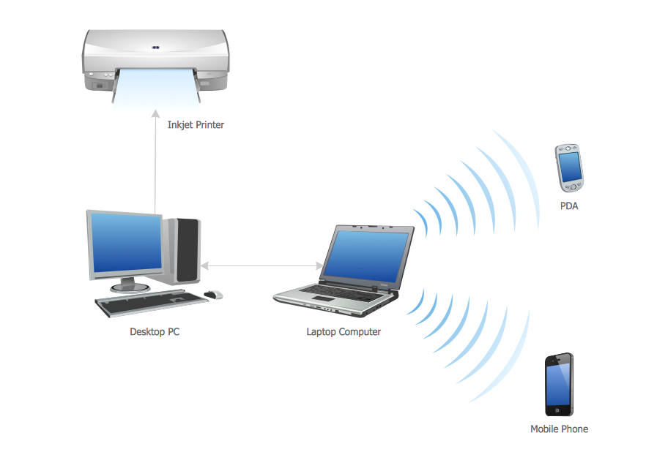
Personal Area Network - PAN
A personal area network, or PAN, is a computer network organized around an individual person within a single building.
A typical PAN would include one or more computers, telephones, peripheral devices, video game consoles and other personal entertainment devices.
Normally PAN connection media is Wireless, hence the PAN is considered as WPAN
Connection Technologies
Bluetooth
ZigBee
Wifi

Slide 16
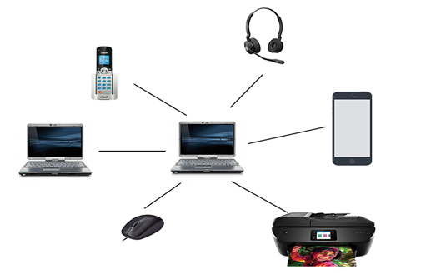
Real Implementation of PAN
This could be inside a residence.
A typical PAN would include a Laptop computers, mobile phone, headset, video game consoles and other personal entertainment devices.
Connection media would be Wireless Technology
Wi-Fi
BT

Slide 17
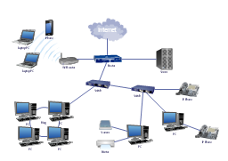
Local Area Network – LAN
A Local Area Network (LAN) is a group of computer and peripheral devices which are connected in a limited area such as school, laboratory, home, and office building.
It is a widely useful network for sharing resources like files, printers, games, and other application. The simplest type of LAN network is to connect computers and a printer in someone’s home or office.
In general, LAN will be used as one type of transmission medium. It is a network which consists of less than 5000 interconnected devices across several buildings.

Slide 18
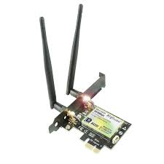
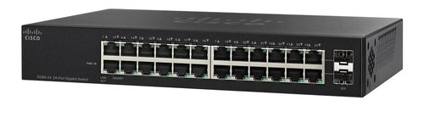
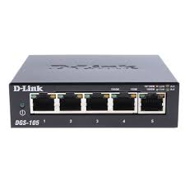
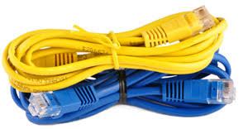
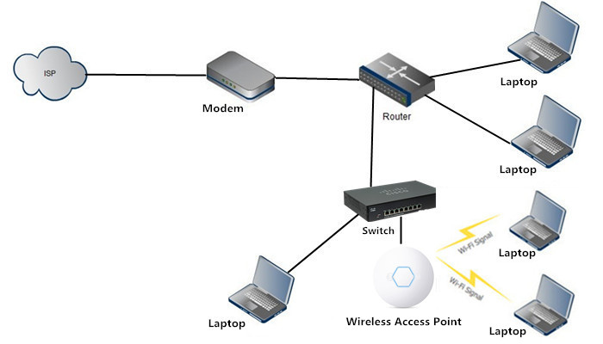
Components of a LAN
End devices
Users’ devices, Sensors, Video/Audio devices
Connection Media
Guided media
Unguided media
Intermediate Devices
Active Devices – Access points, Switches
Passive Devices – Patch panels, Sockets
Core Network and External Connections
Network Servers, Routers, Internet Links

Slide 19
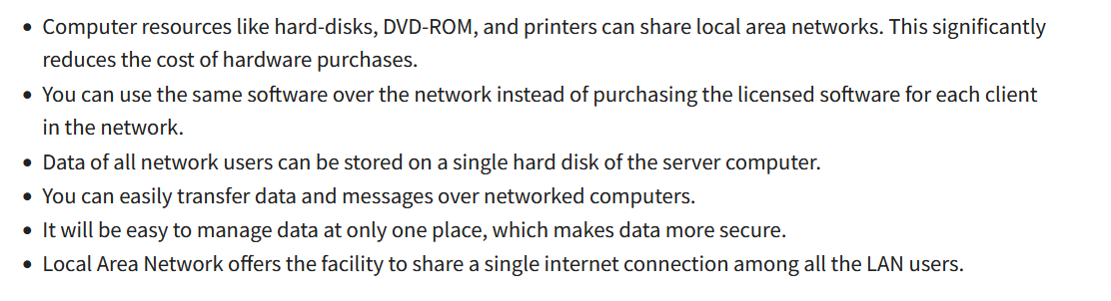
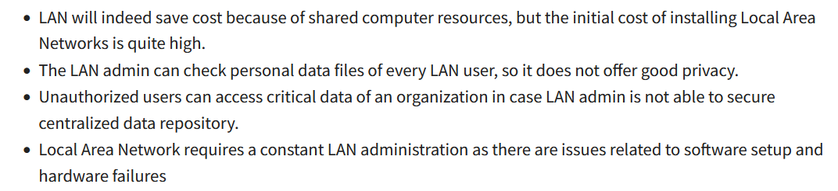
Advantages of LAN
Information Sharing and Resource Sharing
Disadvantages

Slide 20
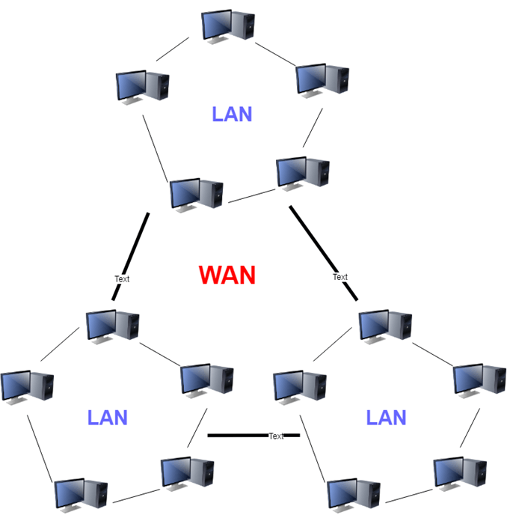
Wide Area Network – WAN
WAN (Wide Area Network) is another important computer network that which is spread across a large geographical area.
WAN network system could be a connection of a LAN which connects with other LAN’s using telephone lines and radio waves.
WAN helps to cover a larger geographical area. Therefore business offices situated at longer distances can easily communicate.
Technologies Use:
Leased lines (Metro Ethernet - Fiber connections) (T1, T3, E1, E3)
Wireless Connections (WiMAX)
Shared networks (DSL)

Slide 21
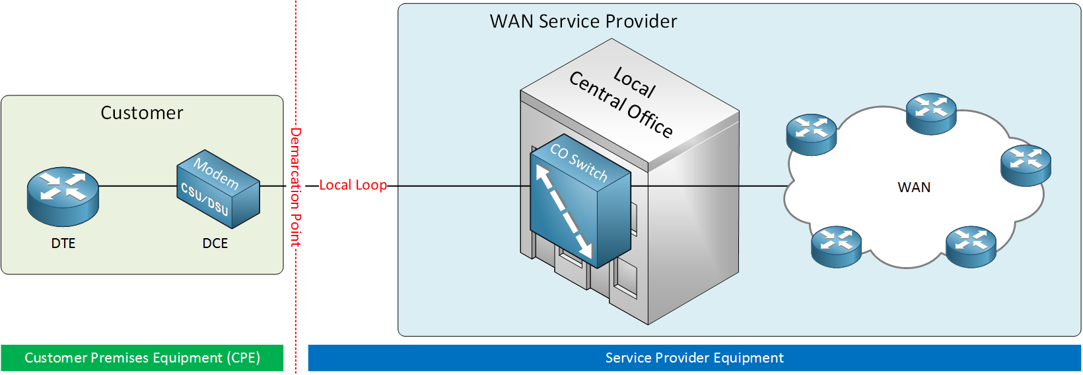
WAN Terminology
Components
LAN
CSU/DSU (Channel Service Unit / Data Service Unit) is a device that sits in between the router and WAN connection. It converts digital signals from the WAN into a digital signal the router understands and vice versa. The DCE (Data Circuit-terminating Equipment) is the device that receives data from the DTE.
The DTE (Data Terminal Equipment) is the customer device that forwards data from the customer’s network to the WAN

Slide 22
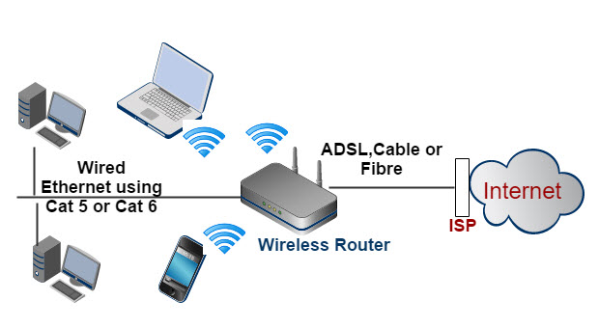
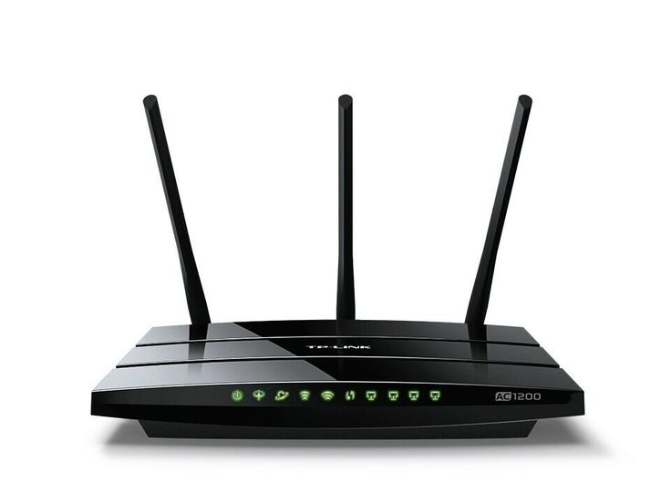
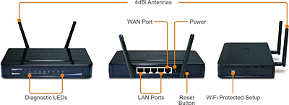
LAN - Simple Home Network
Internet Connection with DSL/Cellular
ADSL - Asymmetric digital subscriber line
Cellular Data connection
Last mile
Fiber/Microwave ( E.g. FTTH, 4G/5G)
Internal LAN is mainly in wifi mode – Flexibility
Magic Device – Wireless Router
It has 5 main functions
Routing, Switching, Access Point, DNS
It can also be configured for filter packets (Firewall)

Slide 23
Small Office Home Office (SOHO) Network
SOHO referred to a business category involving a small number of workers usually from 1 to 10.
One of the most common LAN deployments is the Small-Office / Home-Office LAN (SOHO).
Usually built of one Ethernet switch, one router, and one wireless access point.
The LAN uses Ethernet cables to connect different end-devices to one of the switch ports.

Slide 24
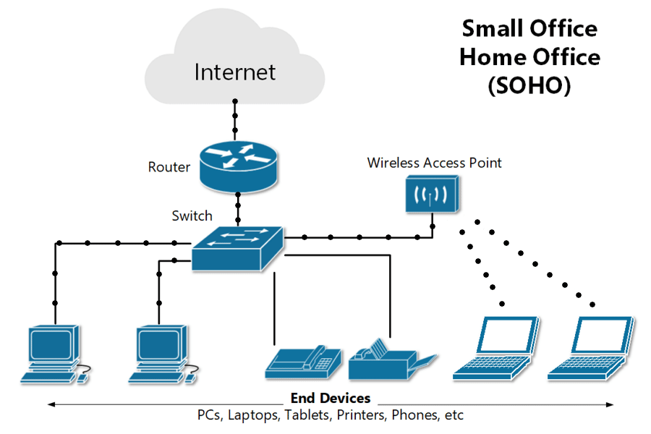
SOHO Network Setup
Limitations:
No guaranteed connection.
No permanent Identifier (IP address block)

Slide 25
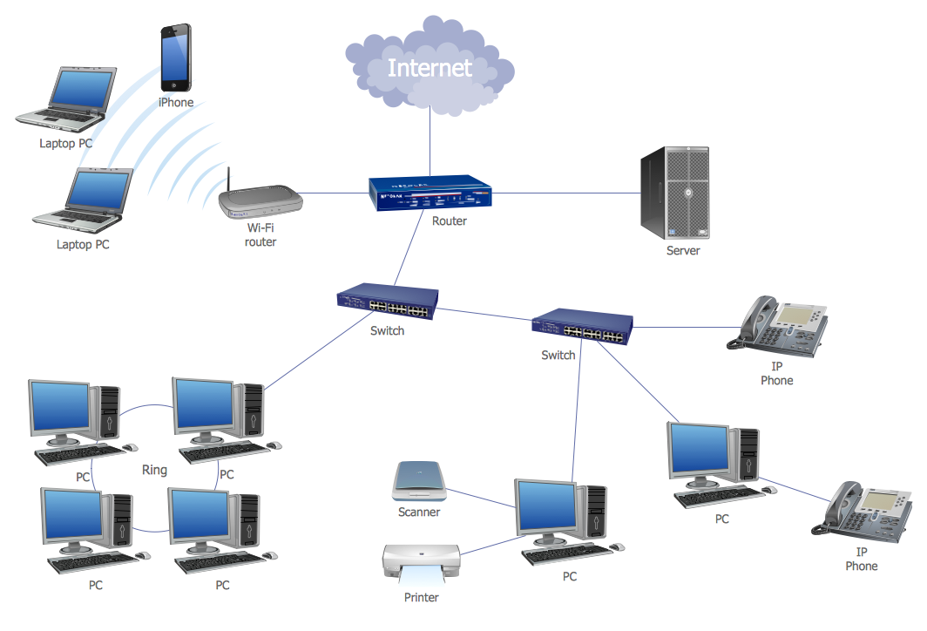
Complex Networks
Office with Leased line connection and own hosting servers
Depend on the user, application and network requirements
Persistent connectivity
Hosting services in own network
E-mail / Web / File servers
Network Segments
Departments/Units/User levels
Guided and unguided media use

Slide 26
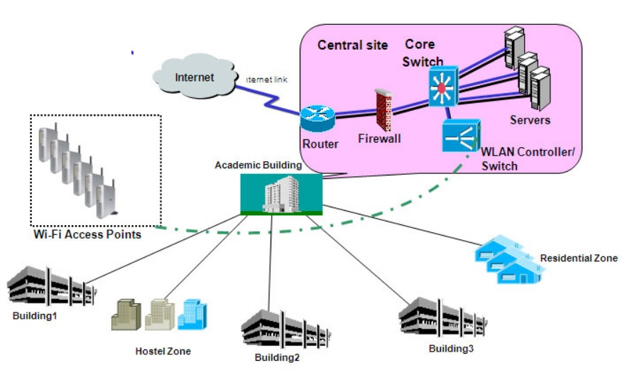
Campus Network
Campus Network spread over several buildings with many network services and having high intranet data volumes
Network between LANs
Sometimes connect external branch networks
More covering area with open space
Different user types

Slide 27
Enterprise Networks
The enterprise network is the backbone of any modern enterprise’s business operations hence very critical for the organizations.
It enable communications and information exchange among an enterprise’s users, business units and trading partners.
The sheer size and diversity of an enterprise network makes it very difficult and costly to build, maintain, administer and secure.
It consists of many devices (End points, intermediate devices, protocols)
E.g. May have dozens or even hundreds of APs that need to be managed in a systematic and centralized manner

Slide 28
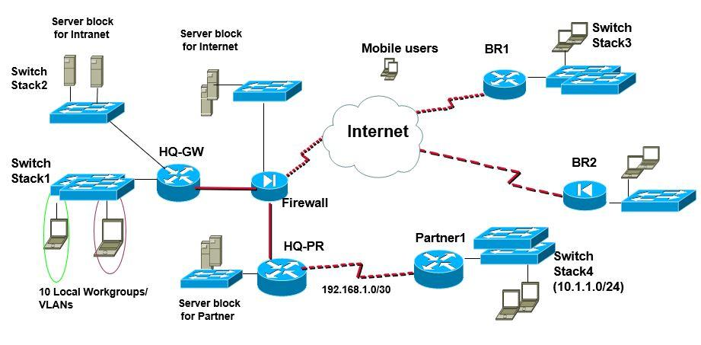
Diversity of Enterprise Network
Centralized services and administration
Different Network technologies – LAN + WAN Heterogenous
High security measures
Many end points with different technologies.

Slide 29
Physical Designing of the Network

Slide 30

What to be Consider in Network Designing
As network designing process is an expensive process and the designed network will be used for a considerable time span.
Hence, it is required to follow standards and best practices in the implementation process. This will allow speed and dependable implementation within a shorter time
Requirements for the network
Connection Media and Devices
Cost /Investment.
Passive Materials and topologies.
Active components technologies.
Deployment and Reliability.
Scalability

Slide 31
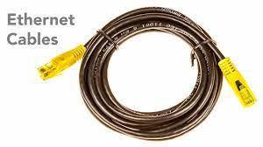
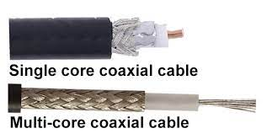
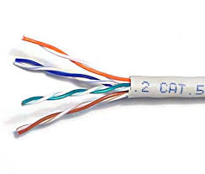
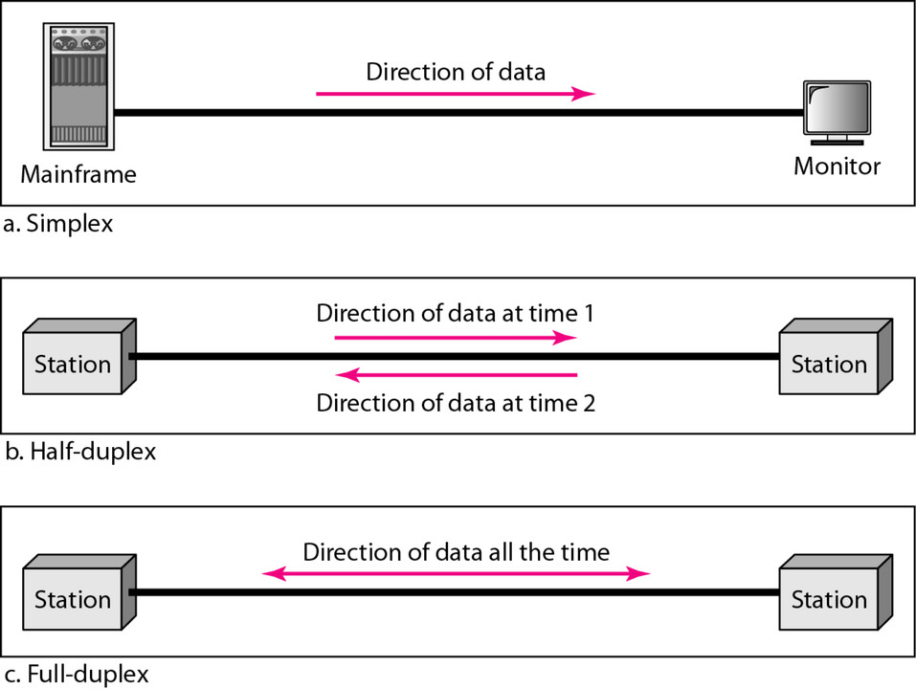
Dealing with the Connectivity
Cabling is the de facto connecting mechanism in many of the networks.
Before 1990’s the cabling systems were proprietary and vender specific and lack in the flexibility → Vender Locking
It was very difficult for upgrades, shifting to other technologies
The changes to the network infrastructure was very expensive and the entire cable structure wanted to change
Mode of operations
Simplex, Half-Duplex and Full duplex
End devices and Intermediary devices

Slide 32


Structured Cabling
A structured cabling system is based on point-to-point cable segments that are installed according to the detailed guidelines and specifications published in the structured cabling standards.
In 1991, TIA and EIA published the first version of “Commercial Building Telecommunications Cabling Standards – TIA/EIA-568
Data caballing involve not only the Structured cabling standards but also has to be inline with fire Safety standards, electrical wiring standards , etc.
ANSI –American National Standards Institute
CENELEC- European Committee for Electrotechnical standardization
BICSI - Building Industry Consulting Service International
ISO/IEC -International Organization for Standardization
TIA/EIA-Telecommunications Industry Association /electronic industry Alliance
ISO/CENELEC used in European countries.
ANSI used by Americans & few
TIA/EIA is the most widely used standard.
TIA/EIA-568 for commercial Buildings.
TIA-942 data center.
We use the 568-B in Sri Lanka

Slide 33
The current TIA/EIA-568 standard
TIA/EIA-568-C.1 - General requirements.
TIA/EIA- 568-C.2 - Components of balanced twisted-pair cable systems
TIA/EIA-568-C.3 -Components of fiber optic cable systems,
TIA/EIA-568-C.4 -Coaxial cabling components

Slide 34
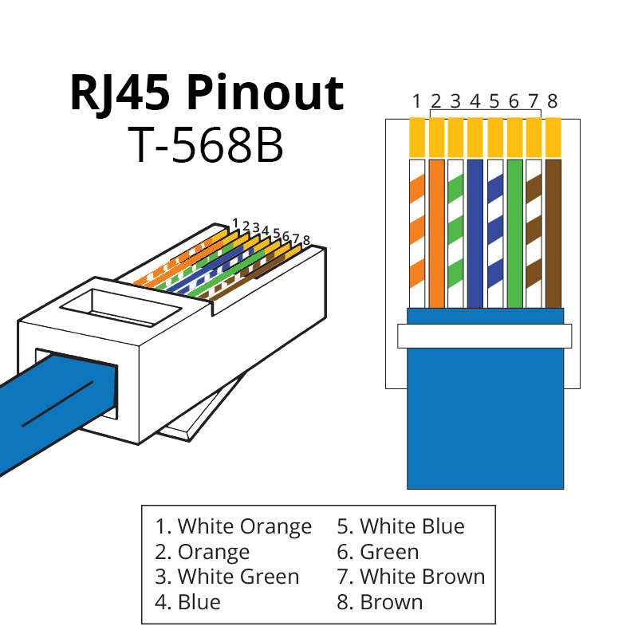
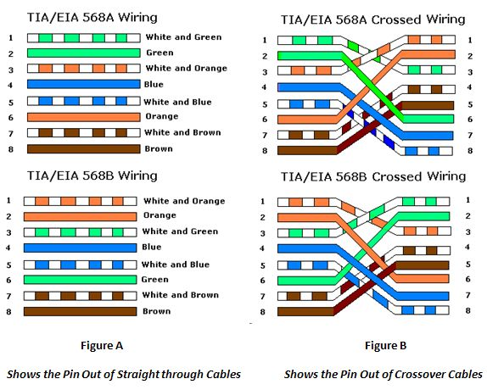
TIA/EIA 568 Standards
TIA/EIA 568A and TIA/EIA-568B standards describes the order of the wires placed in the RJ45 connector.
Functionally, there is no difference between TIA/EIA 568A and TIA/EIA-568B standards.
Only the difference is that the position of Green and Orange wires are switched.

Slide 35
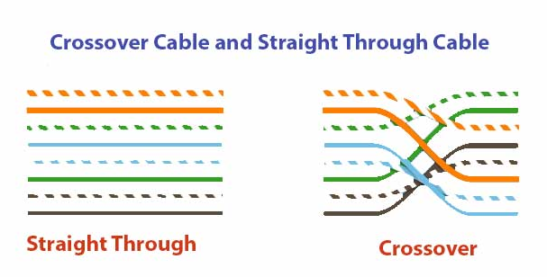
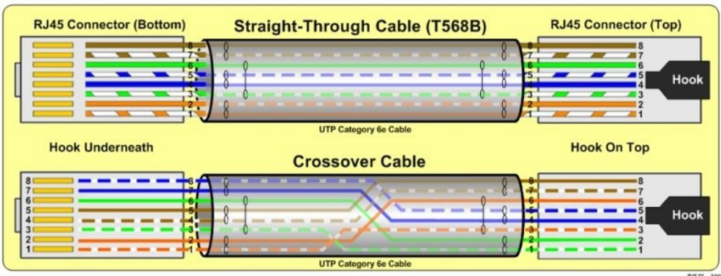
Use of 4 Pairs with RJ45 Connector
Straight Cables in Megabit range
To connect intermediate devices with end devices
2 Pair used for data communication
1,2 for TX
3,6 for RX
Crossover cables
Connect 2 End Devices
2 Pairs are used to data communication

Slide 36
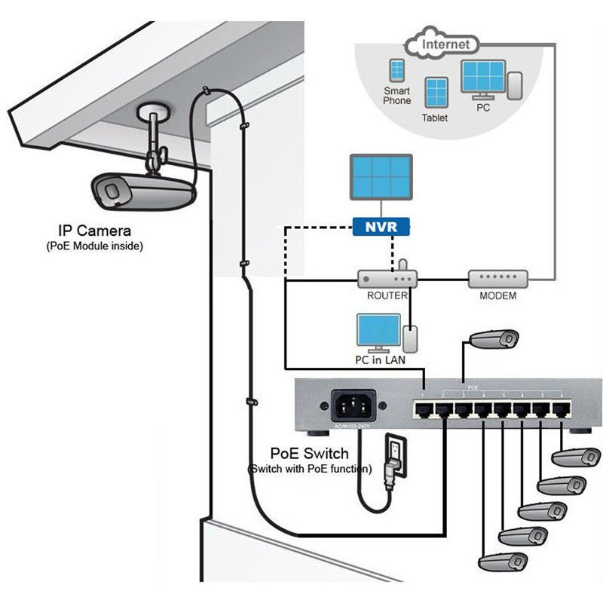
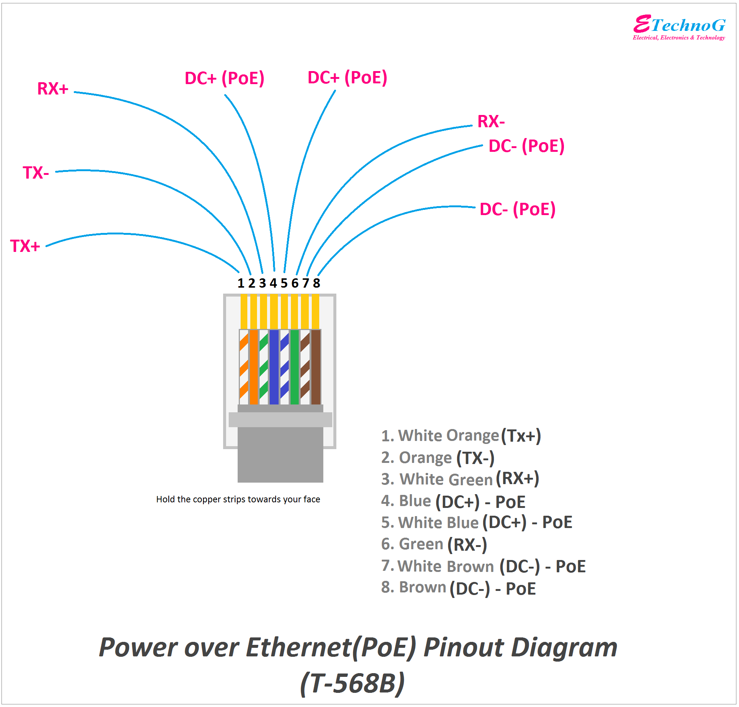
UTP for Power and High-Speed Data Rates
In 100BaseT (100Mbps Twisted Pair Cables), only 2 pairs are used for data communication
1,2,3 and 6
Remaining pairs (4,5,7,8) are used for transfer power for small devices such are CCTV camera, Access points etc.
Need PoE Switches to provide power for the end devices.

Slide 37
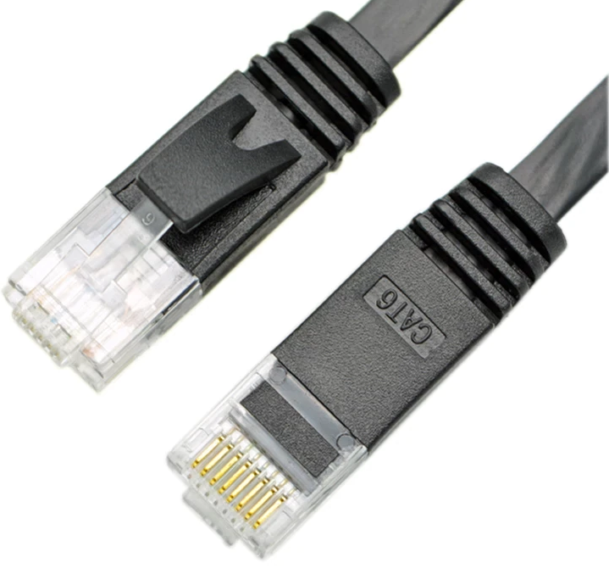
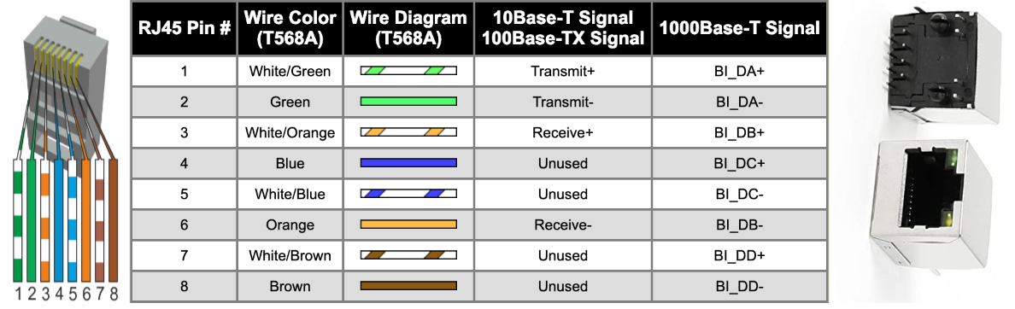
UTP for High-Speed Data (Gigabit Ethernet)
UTP – 1000BaseT uses all 4 pairs for data communication.
CAT 5e, CAT6 and CAT 7 UTP cables
Maximum distance is 100m

Slide 38
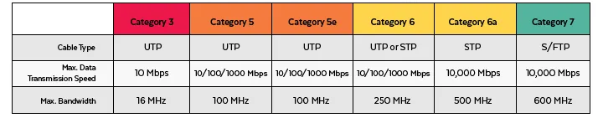


Feature and Specification Comparison

Slide 39


Six Elements of Structured Cabling
Building entrance facilities
Equipment room
Building backbone cabling
Horizontal cabling
Telecommunications closet
Work area

Slide 40
Building Entry Facilities
The entrance facility is the point where outside cabling and services interface with backbone cabling.
(The electrical equivalent would be the meter panel with main Circuit breaker.)
Entrance Facility
The entrance facility may contain public network interface devices as well as telecommunications equipment
The standard recommends that the location of the entrance facility should be in a dry area, close to the vertical backbone pathways
Easy access(for external service persons).
Clear pathways for cables(manholes, handholes, Pullboxes, ducts, conduts, etc)
Viable environmental condition for transmission and network equipment.
Extra space for keeping slack loops of cables.
Space for expansions
Service Provider

Slide 41
Equipment Room
The equipment room is the area of the building where incoming cabling interfaces with electronic equipment.
It is also the main cross-connect (MC) to the backbone cabling.
(The electrical equivalent would be the Main Distribution Panel.)
An equipment room (ER) is defined as any space where telecommunications equipment common to the occupants of a building resides.
Carefully selected location.
Must be secured and controlled access with all viable environmental conditions.
Plenty of Space for expansions and racks.

Slide 42
Selection of Equipment Room
Minimum Size 14 m2 (150 ft2).
The recommended practice is to provide 0.07 m2(0.75 ft.2) of equipment room space for every 10 m2(100 ft.2) of usable floor space (work areas)
A single centralized space housing.
Close Proximity to Backbone cables.
Sufficient space to house all equipment related to communication.
Secure area with restricted access to visitors.

Slide 43
Selection of Equipment Room cont..
Floor loading capacity is sufficient to bear both the distributed and concentrated load.
Enough capacity on HVAC, a dedicated single refrigerant circuit system preferred.
Must have a door more than 90cm in width (120 cm Is preferred). 2m in height(no outside windows).
EM/temperature insulation.
Proper Grounding is required (less than 5Ω )
Fire suppression system

Slide 44


Backbone Cabling
Connecting different floors and different buildings

Slide 45

Horizontal Cabling
Horizontal consists of the pathway and cabling that extends between the Telecommunications Room and the Work Area.

Slide 46

Telecommunication Closet
The telecommunications room (TR) formally known as telecommunications closet (TC) is defined as the space that acts as the common access point between backbone and horizontal distribution pathways.
It houses telecommunications/networking equipment, as well as the cross-connection (patch panels) between backbone and horizontal cabling.
i.e. Horizontal Cross-connect (HC) (The electrical equivalent would be the circuit breaker panel, Distribution board.)

Slide 47
Telecommunication Closet – Technical Requirements
Preferable to locate the TC in the core area.
Multiple TC required
The usable floor area to be served is greater than 1000 m2 (10 000 ft.2)or 75% of total floor)
The length of horizontal distribution cable required to reach the work area is greater than 90 m (295 ft.).
Similar environment requirement as ER
Desirable to have a power panel installed in the TC separated from other equipment.
Room penetrations (sleeves, slots, horizontal pathways) be properly fire stopped.
Security and fire protection are to be provided.
continuous Heating, Ventilation and Air Conditioning (HVAC)

Slide 48
Work Area
Work Area is where personal computers, telephones, printers, etc are located. It also includes equipment cords that connect the device to the horizontal cable.
Work areas are generally described as locations where building occupants interact with telecommunications devices.
General rule is one WA =10m2.
Must placed enough outlets depending on the application.
The standard office separation (partition) systems provide space for cables and outlets.

Slide 49
How to do the physical designing
Identify port the requirement in each area /department /floor/building separately.
Working areas, meeting spaces, guest area etc
Map the ports on the floor design/diagram.
Identify the equipment rack locations.
Calculate /estimate network load and traffic types in rack
Identify the cable path.

Slide 50



Material selection
Ones the Path is finalized select the material suitable based on physical requirements.
The materials must also reflect the business requirement now and future .
The safety ,regulatory, standards and other requirements will finalize the technical specification of the materials.

Slide 51
Ducts Floors and Cable trays
Access Floor
The access floor is made up of modular floor panels supported by pedestals with or without lateral bracing.
Used in equipment rooms as well as general office areas.
It is necessary to design floor penetrations for the type and number of work areas.
Good for constructing unplanned office spaces.
Expensive but will save time and money in the long term.
Cable Trays/Wire ways /Ladders
These are prefabricated, rigid structures consisting of side rails and a solid or ventilated bottom, used for the containment of telecommunications cables.
Trays and wireways can be located above or below the ceiling in plenum or non-plenum applications.
For general practice is to provide 650 mm2 (1 in.2) ofcross-sectional tray or wireway area per 10 m2 (100 ft. 2) of usable floor space.

Slide 52



Power Cabling
Must Protect Data lines from noise coupling from sources such as electrical power wiring, radio frequency (RF) sources, large motors and generators, induction heaters, and arc welders.
Increased physical separation
Electrical branch circuit line, neutral, and grounding conductors should be maintained close together (e.g., twisted, sheathed, taped, or bundled together) for minimizing inductive coupling into telecommunications cabling
Use of surge protectors in branch circuits can further limit the propagation of electrical surges
Use of fully enclosed, grounded metallic raceway or grounded conduit.
Use shielded cables when required.

Slide 53



Physical Designing …
Ones all the rack locations are finalized backbone path can be identified
Identify the core distribution point to have the distribution switch.
Identify the location for building entrance and server room.
Identify the Path to connect all the building to the main Server room.
Also need to consider the WAN connectivity and service provider’s requirements

Slide 54
Important on physical designing
The physical implementation cost is only 20% of the entire network cost
80% will be sed to maintain the network for the expected lifespan.
If the physical design is done properly both the implementation and the running cost can be reduced.
Do not overengineer a solution it will increase the cost as well as waste lot of recourses.
The current life span is around 5 years for active and 15 years on passive and is getting shorter each year with technology advancement.

Slide 55
Discussion Time

